Slide 1
Welcome to
Our Sunday School
We’ll start at 9:07
visit OurSundaySchool.com for more about our class

Slide 2
Today’s class (pages 155-168)
Philippians 2:19-24

Slide 3
Philippians 2:19-21 (CSB)
Now I hope in the Lord Jesus to send Timothy to you soon so that I too may be encouraged by news about you. For I have no one else like-minded who will genuinely care about your interests; all seek their own interests, not those of Jesus Christ.

Slide 4
Philippians 2:22-24 (CSB)
But you know his proven character, because he has served with me in the gospel ministry like a son with a father. Therefore, I hope to send him as soon as I see how things go with me. I am confident in the Lord that I myself will also come soon.

Slide 5
Today’s class (pages 155-168)
Philippians 2:19-24

Slide 6
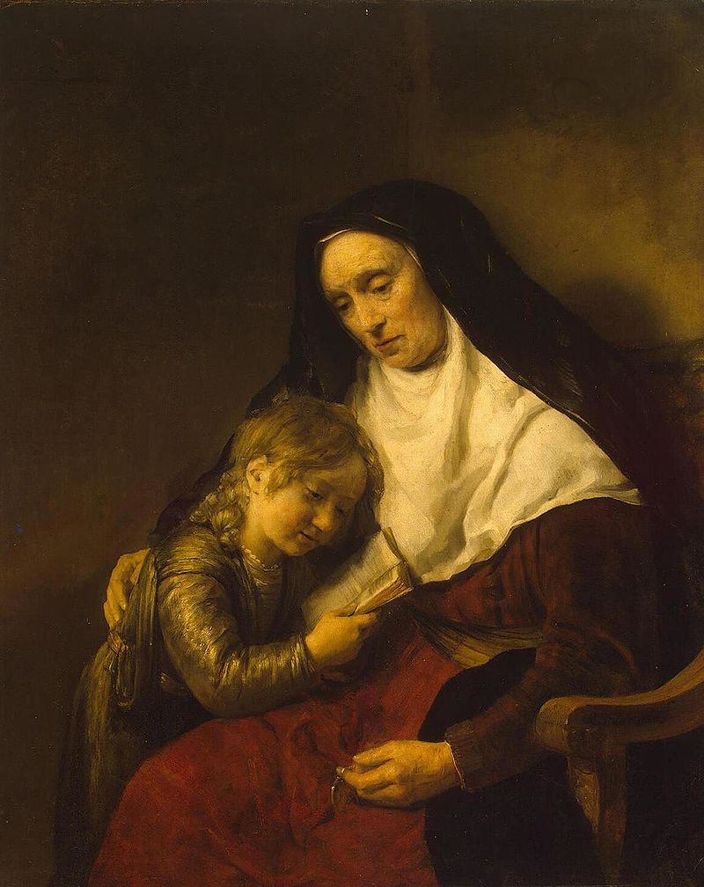
Timothy
Acts
Romans
1 Corinthians
Philippians
Colossians
1 Thessalonians
Rembrandt’s Timothy and his grandmother, 1648

Slide 7
Timothy
2 Thessalonians
1 Timothy
2 Timothy
Philemon
Hebrews
Rembrandt’s Timothy and his grandmother, 1648

Slide 8
Today’s class (pages 155-168)
Philippians 2:19-24

Slide 9
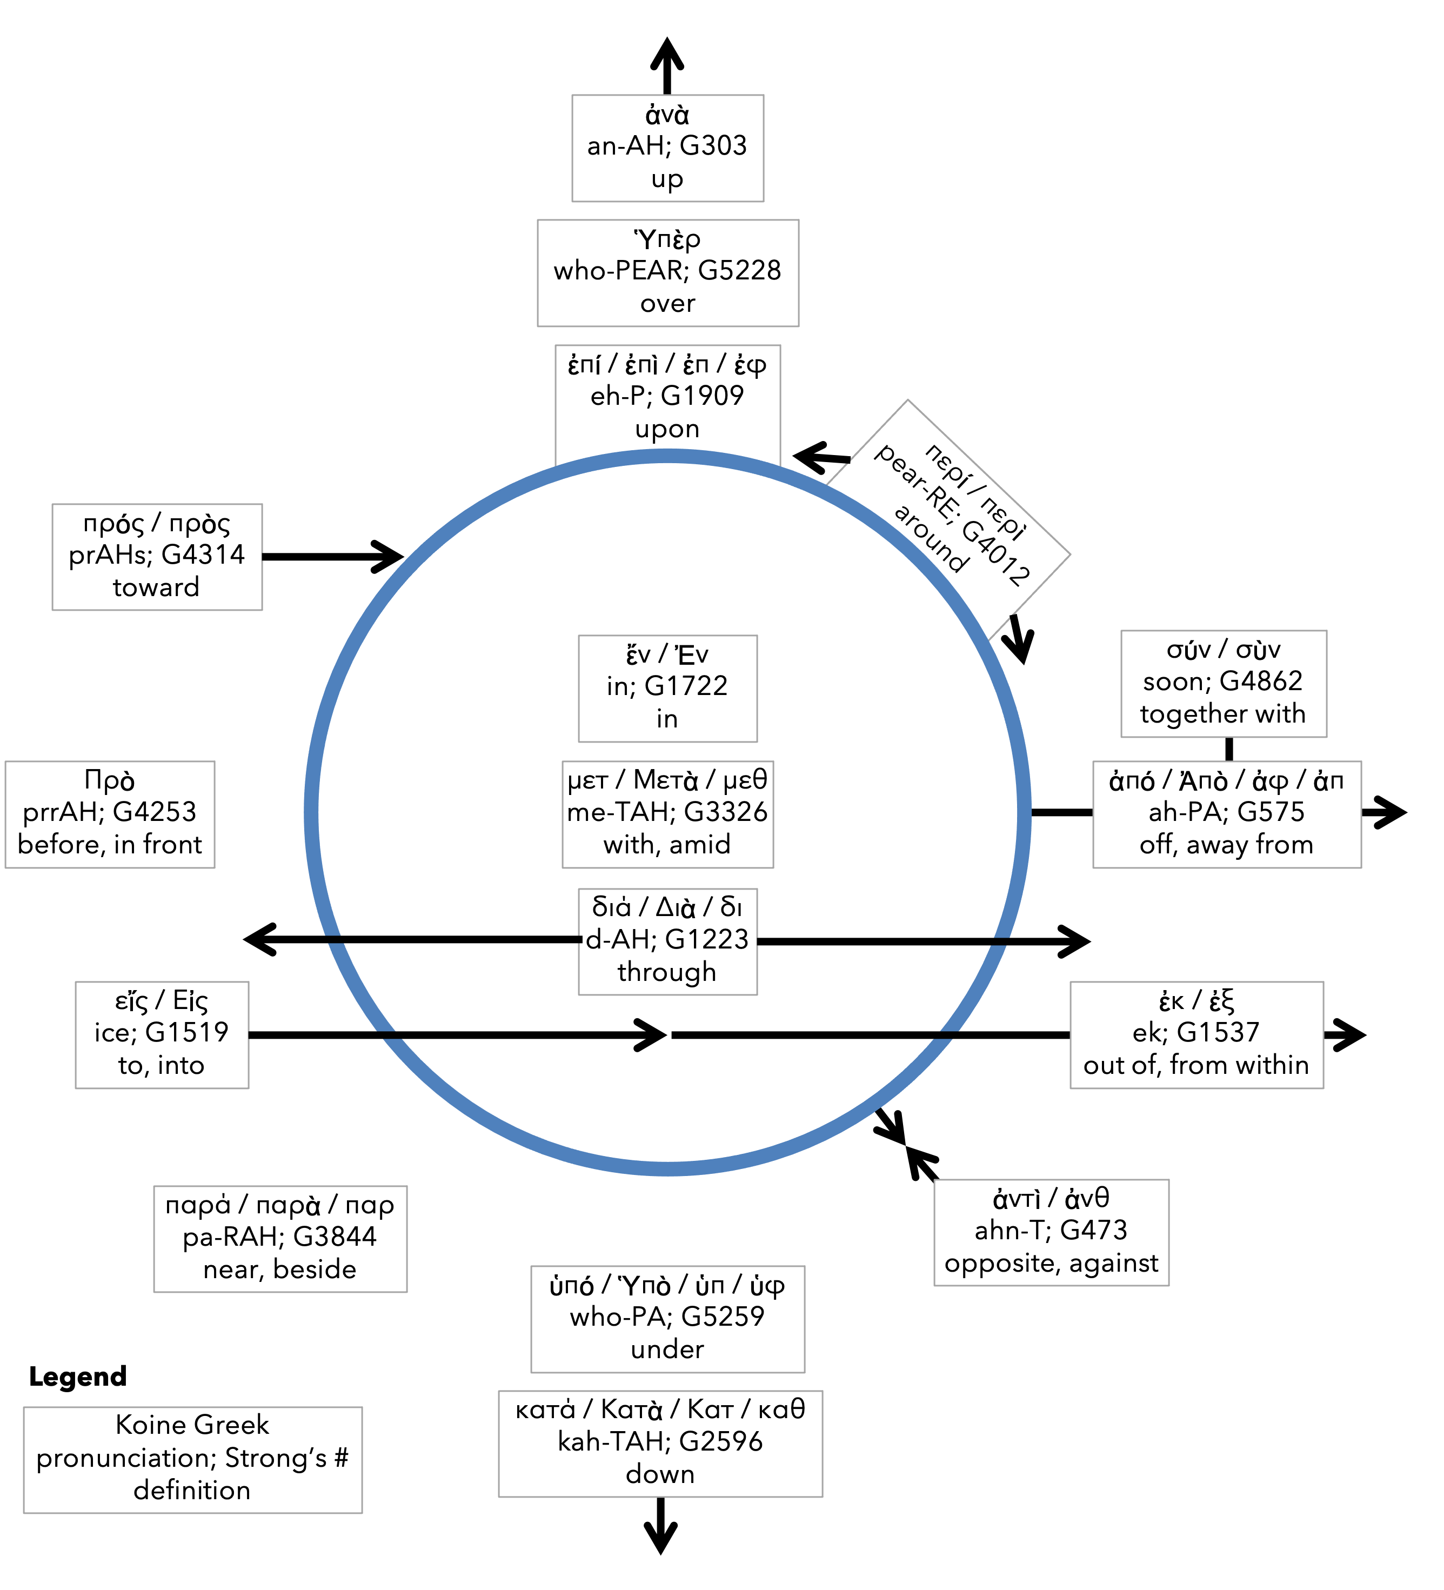
Preposition circle (page 11)

Slide 10
Preposition circle (page 11)

Slide 11
Today’s class (pages 155-168)
Philippians 2:19-24

Slide 12
Prayer Time
Write down your prayer requests (on the Weekly Update or in the comments)
Lean in, engage, and pray for someone not with you
Go worship

Slide 13
Today’s class (page 16)
Preparing for Philippians 1:1-30
Pray with others
Hear with others
Think with others
Study with others In class, as a table
Share with others
Invite others After class
In class, as a class

Slide 14
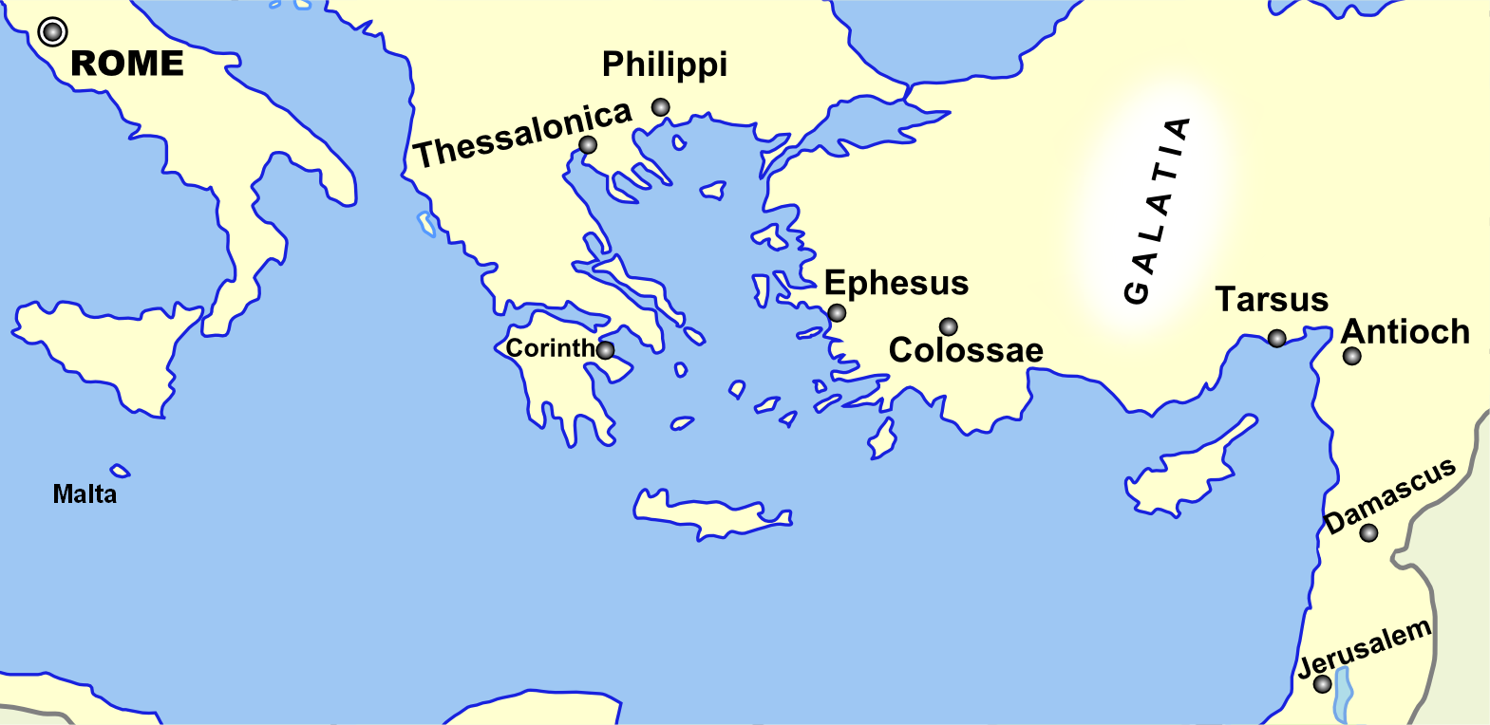
Monozigote. (2012). Broad Overview of Geography Relevant to Paul of Tarsus [Map]. Wikipedia.

Slide 15
Preposition circle (page 11)

Slide 16
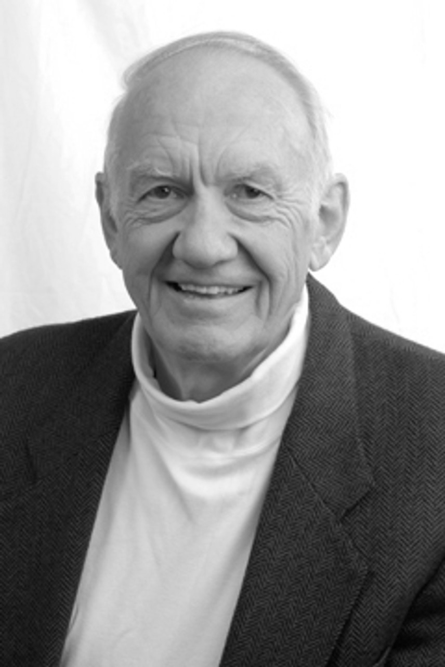
Dr. Gordon Fee Quote

Slide 17
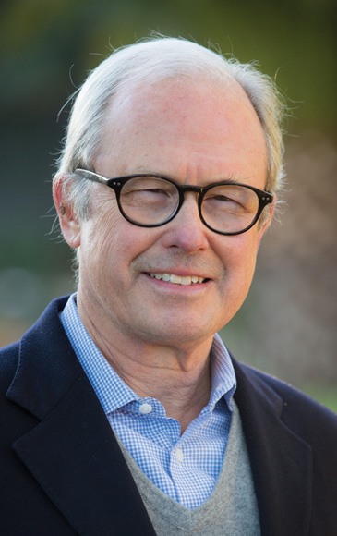
Dr. G. Walter Hansen Quote

Slide 18
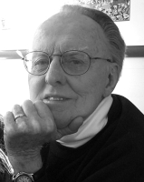
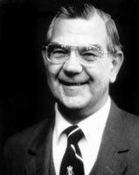
Dr. G. F. Hawthorne & Dr. Ralph P. Martin Quote

Slide 19
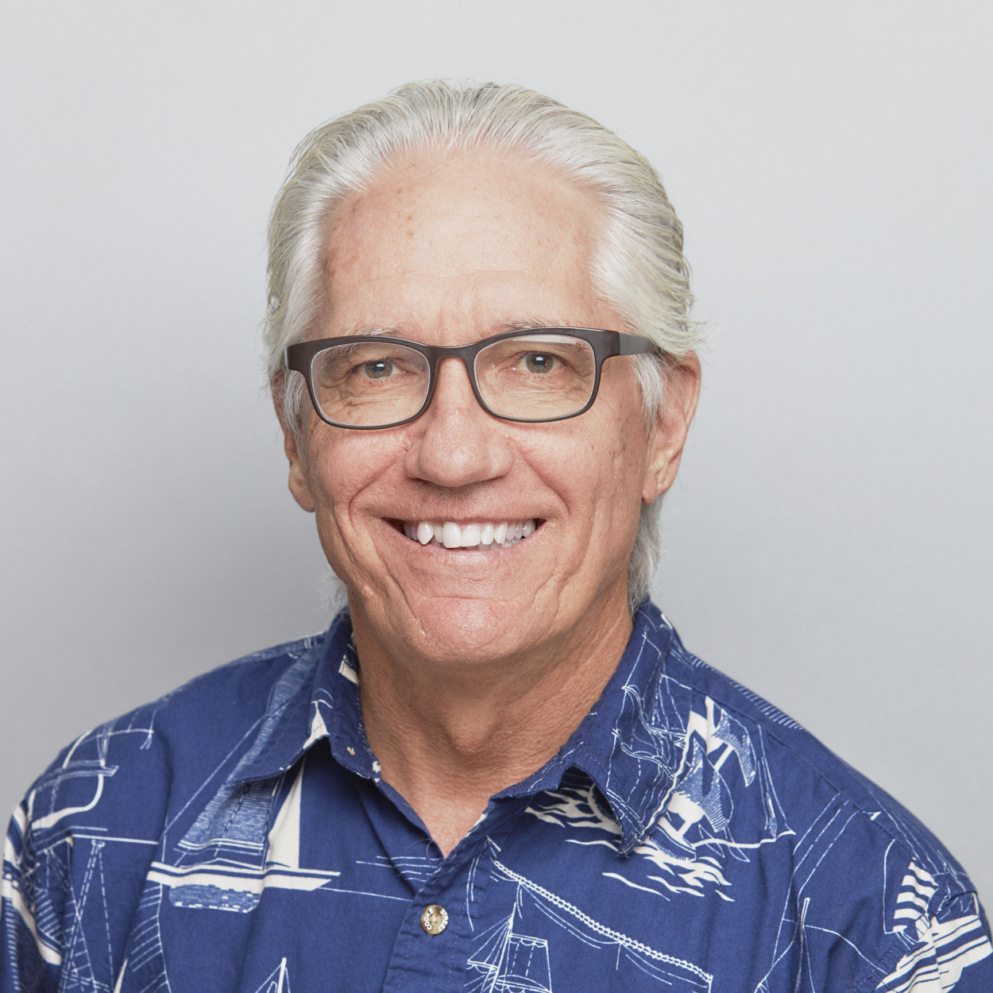
Dr. Joe Hellerman Quote

Slide 20
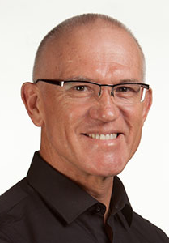
Dr. Mark Keown Quote

Slide 21
Dr. Ralph P. Martin Quote

Slide 22
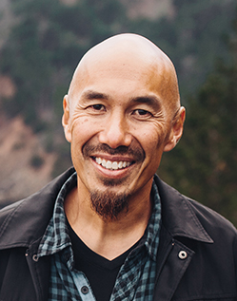
Dr. Tony Merida & Frances Chan Quote

Slide 23
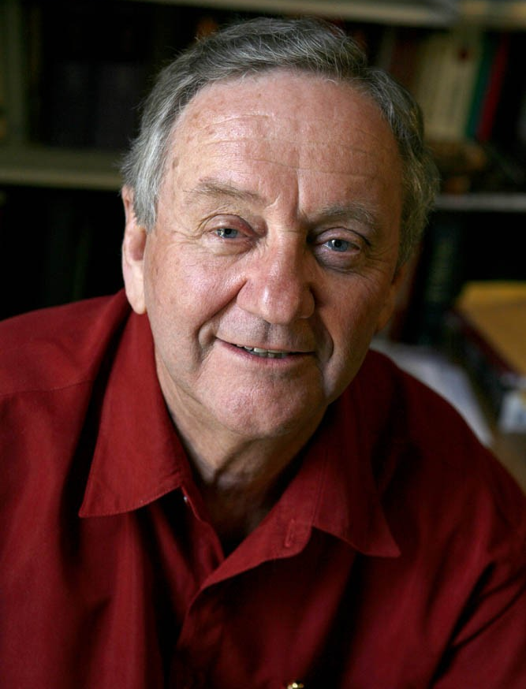
Dr. Peter T. O’Brien Quote

Slide 24
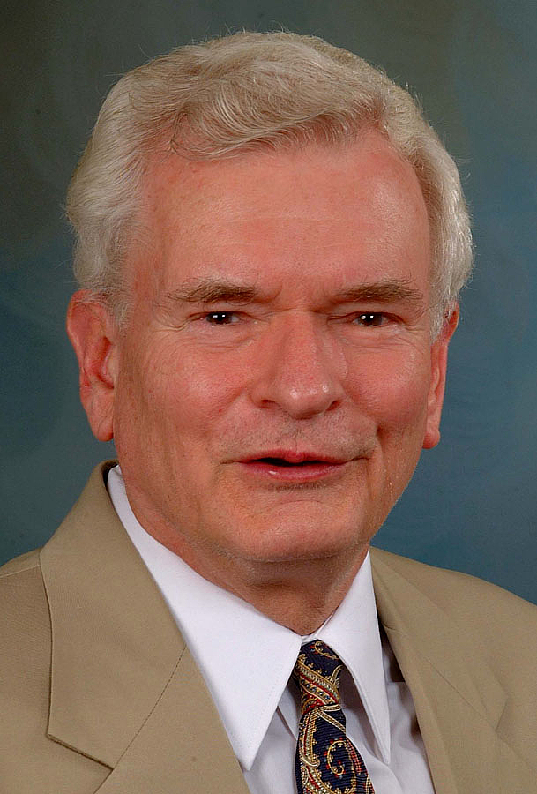
Dr. John Reumann Quote

Slide 25
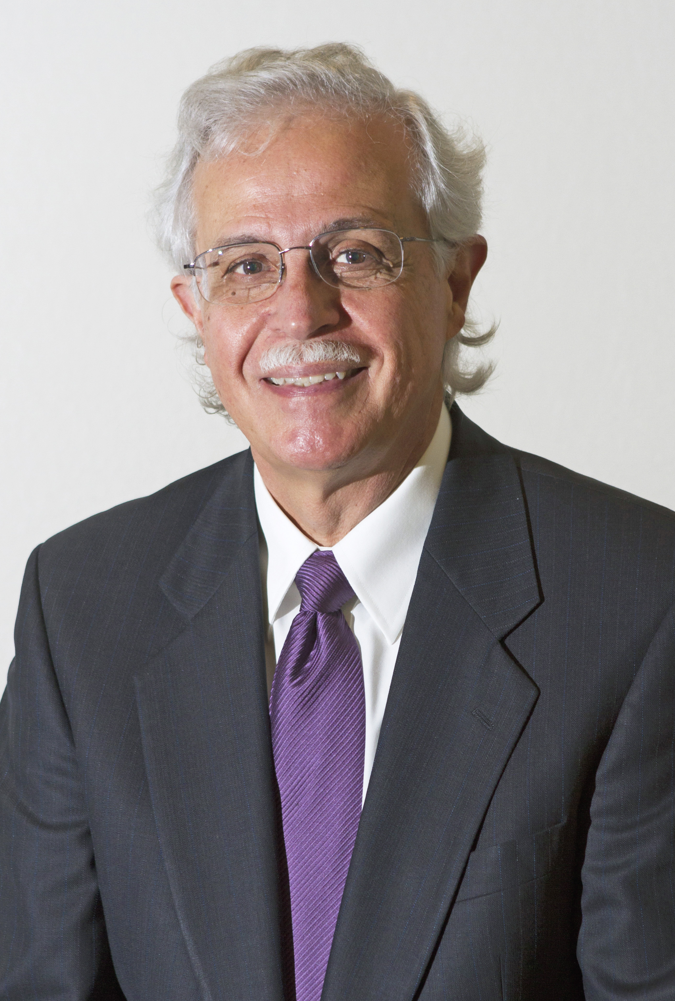
Dr. Moises Silva Quote

Slide 26
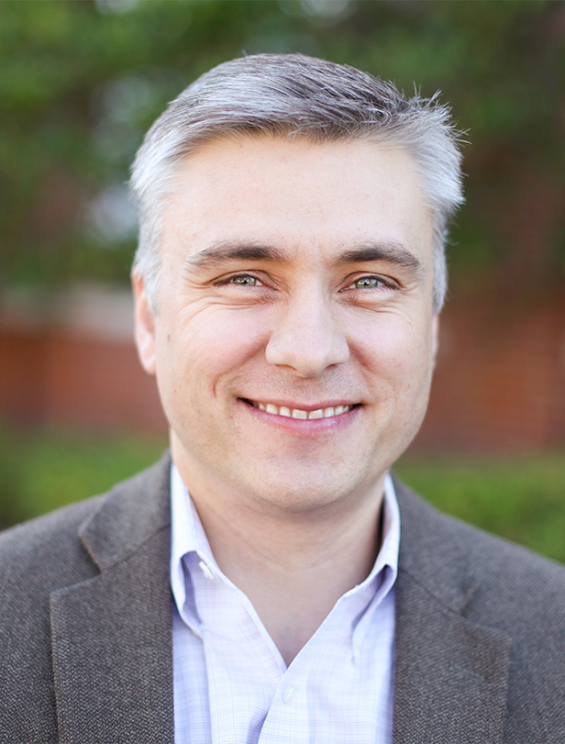
Dr. David T. A. Strain Quote

Slide 27
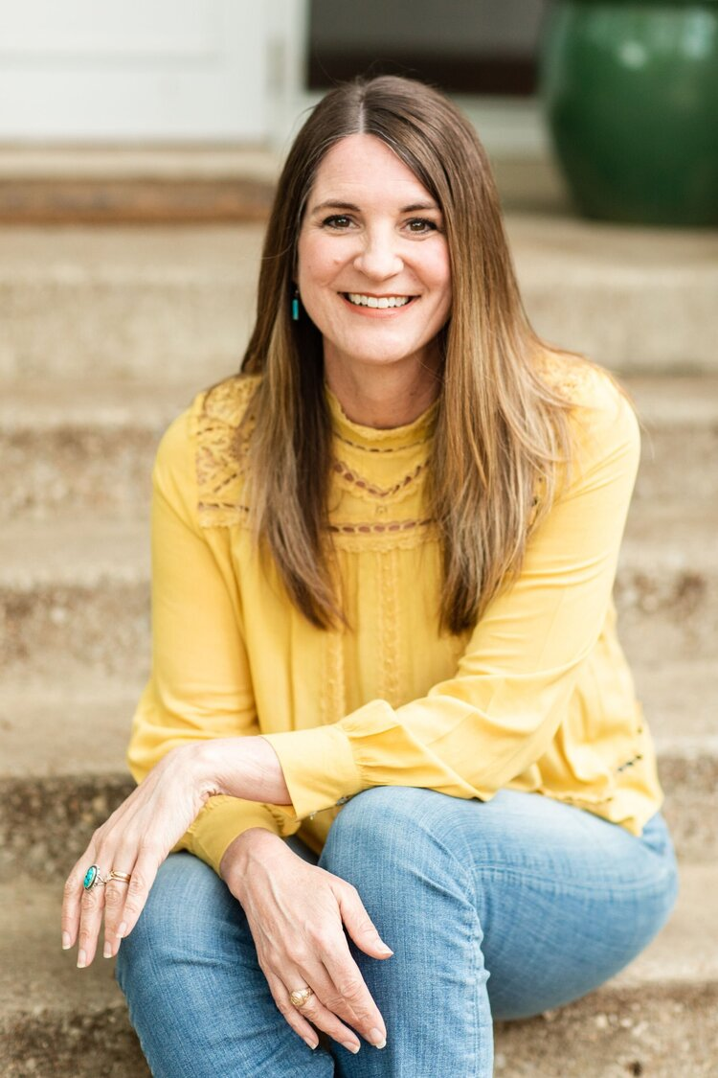
Jen Wilkin Quote

